Slide 1


Slide 2

Predikcija kašnjenja letova koristeći Azure Machine Learning
Bojan Mišić
Merit Solutions, Inc.
12.05.2018.
tweet #tarabica18

Slide 3












Sponzori
Partneri konferencije
Zlatni sponzori
Srebrni sponzori
Tehnički sponzor
tweet #tarabica18

Slide 4

Agenda
Problem description & scenario
Technology & Methodology
Solution architecture & tools
Demo
Conclusion & comments
tweet #tarabica18

Slide 5
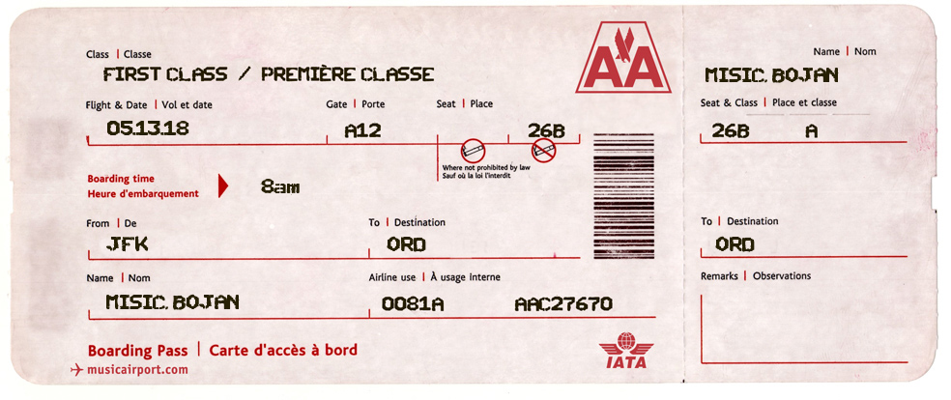
Flight Delay reasons
Airline glitches
Severe weather
Mechanical issues
Security issues
Air Traffic congestion
etc…
THE QUESTION: IS THE FLIGHT GOING TO BE DELAYED?
(more specifically: is the flight going to be delayed 15mins or more?)
tweet #tarabica18

Slide 6
The scenario - AirTarabica
AirTarabica company wants to minimize their flight delay costs
They have monthly flight and weather data for the following month (on-premises)
At the start of each month they would like to know how many delays are to be expected and at which airports
Use that intelligence to act accordingly beforehand
tweet #tarabica18

Slide 7
Technology & Data
Azure Machine Learning
Azure Blob Storage for data persistency
Azure Data Factory for orchestrating the data movement in the solution
Apache Spark in Azure HDInsight for Big Data analytics
PowerBI for visualizing and analyzing results
US Department of Transportation data for Flight Delay data
(https://www.transtats.bts.gov/DL_SelectFields.asp?Table_ID=236&DB_Short_Name=On-Time)
Weather Underground API
tweet #tarabica18

Slide 8
Microsoft’s AI platform
Consume existing models
  Cognitive services API:
    Vision, Speech, Knowledge, Language, Search
  Microsoft Bot Framework
  Cortana
Build your own
  Azure Machine Learning
  CNTK (Microsoft Cognitive Toolkit) – open source Deep Learning framework
tweet #tarabica18

Slide 9
Azure Machine Learning
Azure Machine Learning services
  Azure ML Workbench
  Azure ML Experimentation Service
  Azure ML Model Management Service
Azure Machine Learning Studio
  Simple, browser-based, visual drag-and-drop authoring environment
Data Science Virtual Machine (DSVM)
  Pre-configured environments for data scientists
  Seamless integration with Azure services
tweet #tarabica18

Slide 10
Methodology – Team Data Science Process
Agile, iterative data science methodology to deliver predictive analytics solutions and intelligent application efficiently
Best practices and structures from Microsoft and others in the Data Science industry
Key components of the TDSP:
  A data science lifecycle definition
  A standardized project structure
  Infrastructure and resources for data science projects
  Tools and utilities for project execution
tweet #tarabica18

Slide 11
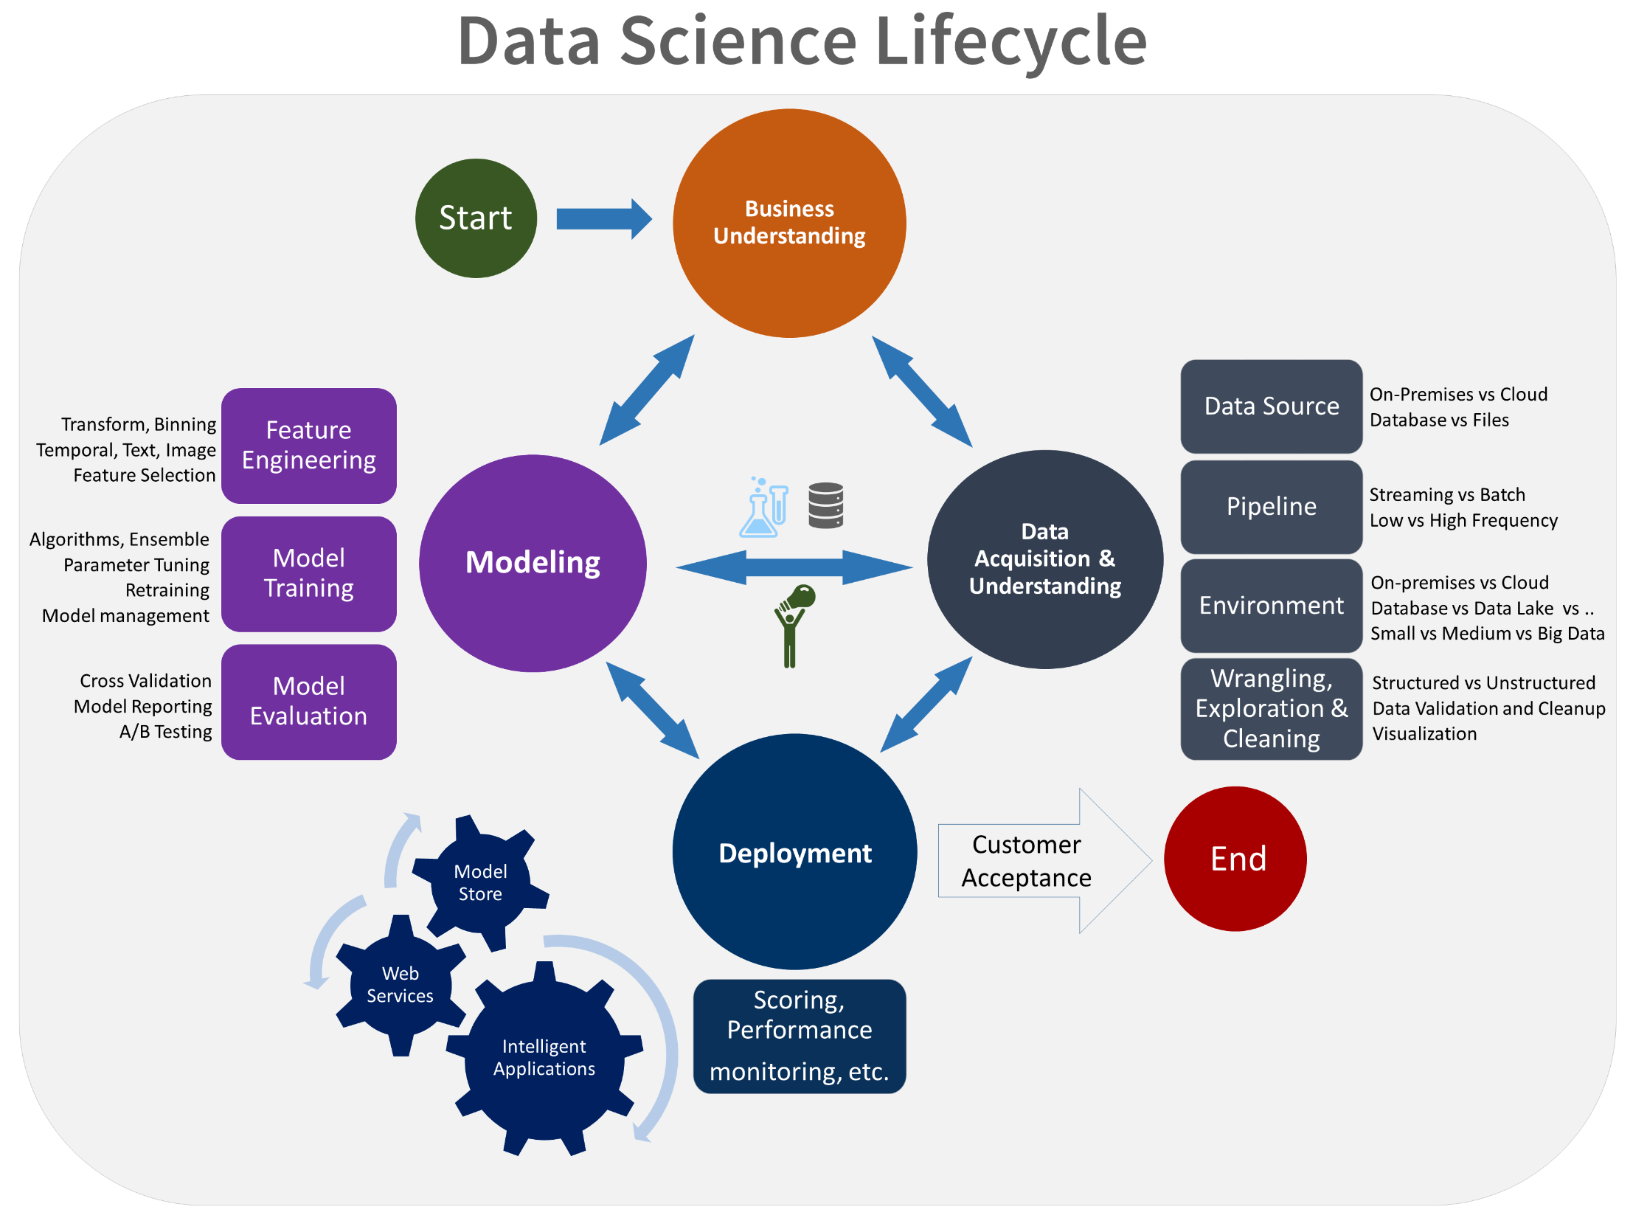
tweet #tarabica18

Slide 12

Azure Machine Learning Studio
GUI-based integrated development environment for constructing and operationalizing Machine Learning workflow on Azure
Free & Standard tiers (Free – 100 modules per experiment, 1 hour per experiment, 10GB storage, single-node execution)
Azure Subscription not required for Free tier
https://studio.azureml.net
Pricing: https://azure.microsoft.com/en-us/pricing/details/machine-learning-studio/
tweet #tarabica18

Slide 13
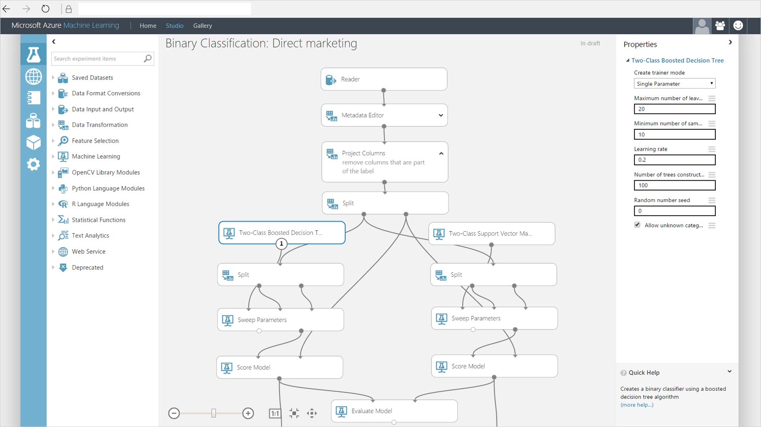

Slide 14
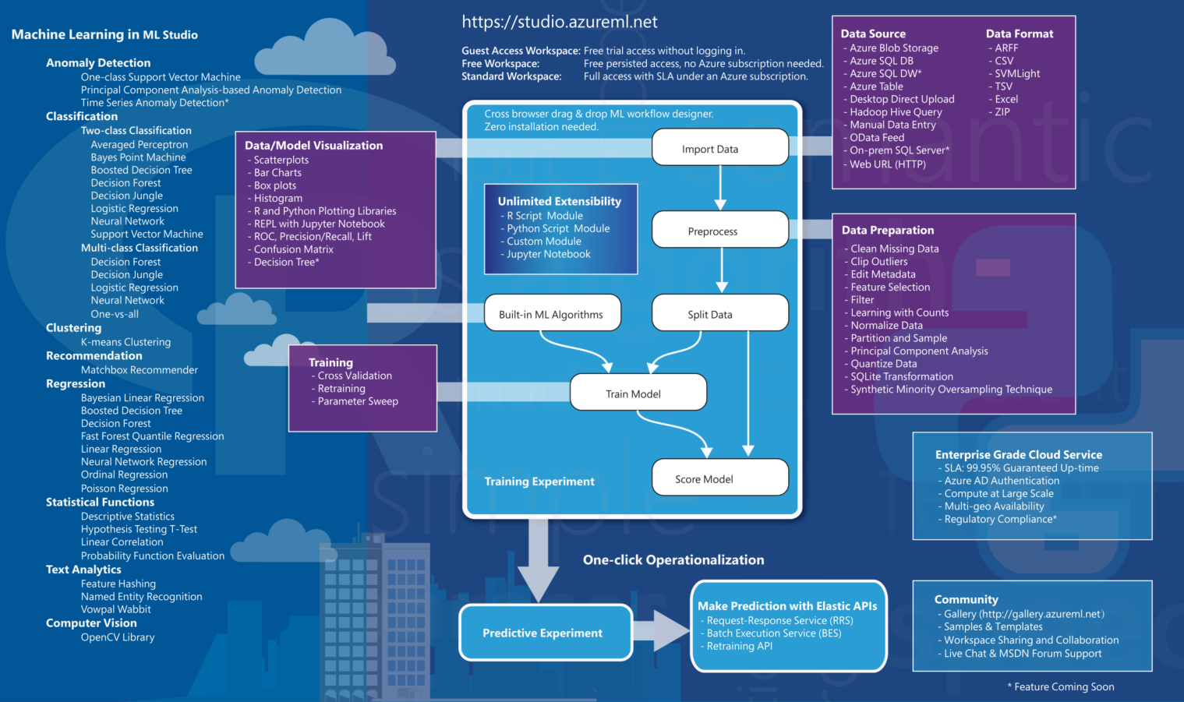
tweet #tarabica18
https://docs.microsoft.com/en-us/azure/machine-learning/studio/studio-overview-diagram

Slide 15
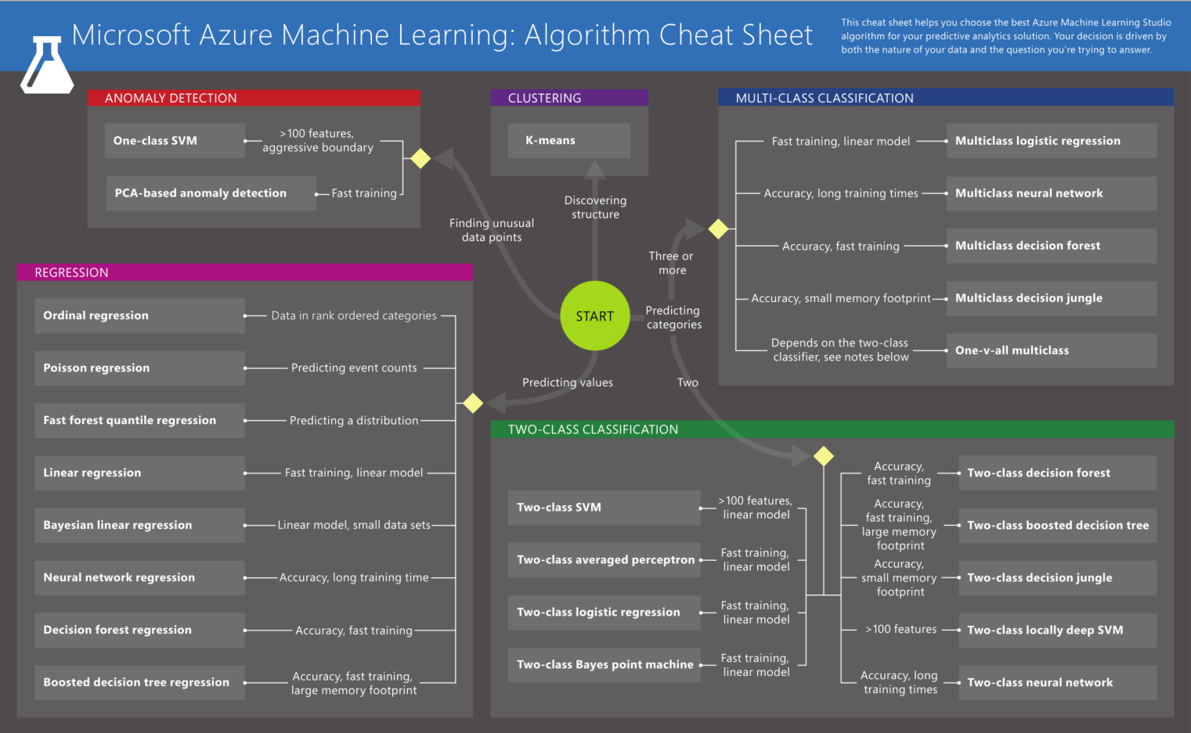
tweet #tarabica18
https://docs.microsoft.com/en-us/azure/machine-learning/studio/algorithm-cheat-sheet

Slide 16
Let’s Learn!
tweet #tarabica18

Slide 17
Let’s explore other components
Data Integration with Azure Data Factory
  Access and ingest data with connectors (gateways)
  Build and manage data flow (pipelines) with codeless UI
HDInsight Spark for Big Data analytics
  Create Apache Spark cluster on Azure
  Run Spark SQL queries against Hive tables
PowerBI report
  Visualize results
tweet #tarabica18

Slide 18
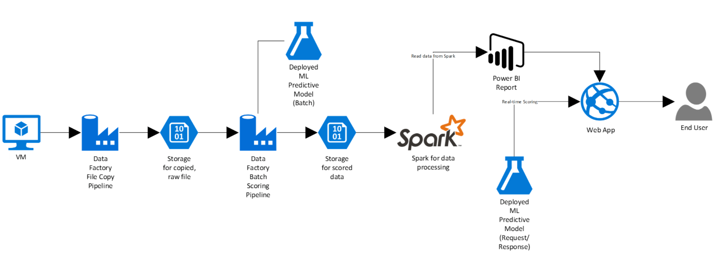
Full Solution Architecture
tweet #tarabica18

Slide 19
Conclusion
We’ve defined a business problem for Flight Delays
We have used open, publicly available data sets for Flight and Weather data
We’ve used Microsoft’s AI platform (Azure Machine Learning Studio) to create a Machine Learning model and expose it as a Web Service
We have used Azure Data Factory to orchestrate data movement and define two pipelines:
  Move data from on-premises to Azure Blob Storage
  Send data from Azure Blob Storage to the Web Service for Batch Prediction
We’ve summarized the scored data using Spark Cluster on HDInsight
We’ve queried summarized data from PowerBI using direct query and visualized the results using interactive reports
tweet #tarabica18

Slide 20

Questions? / Thank you!

